Slide 1
Ch.15 File Input/Output

Slide 2

What you will learn in this chapter
Learn about concepts and functions related to input/output .
The concept of strips
Standard Input/Output
File Input/Output
Input/output related functions

Slide 3
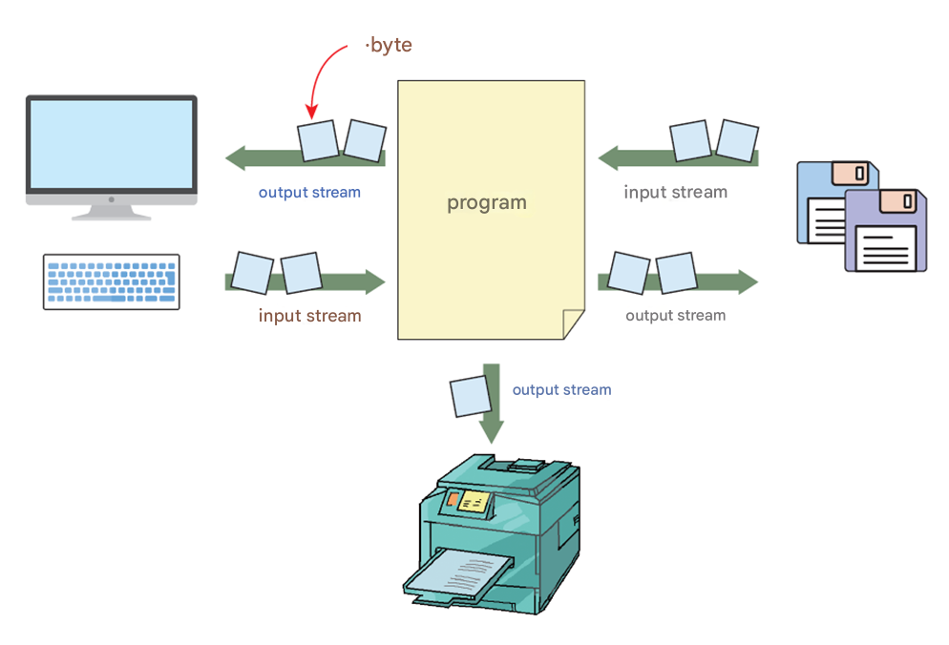
The concept of stream
Stream : Thinking of input and output as a flow of bytes .

Slide 4
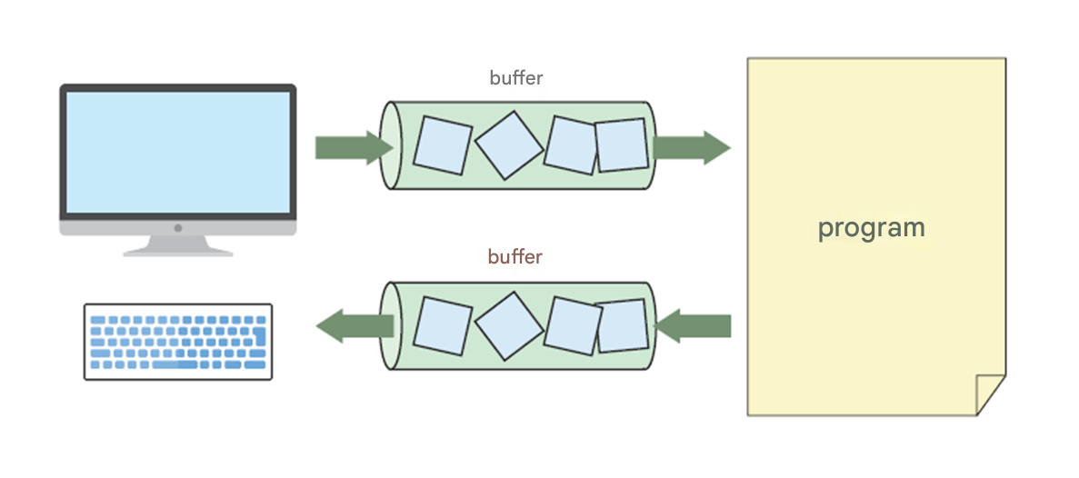
Streams and Buffers
A stream contains a buffer by default .

Slide 5
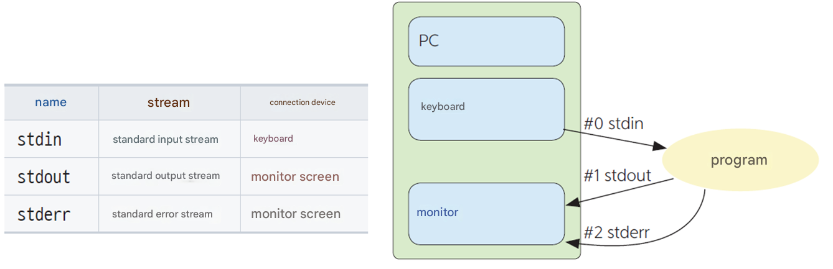
Standard Input/Output Streams

Slide 6
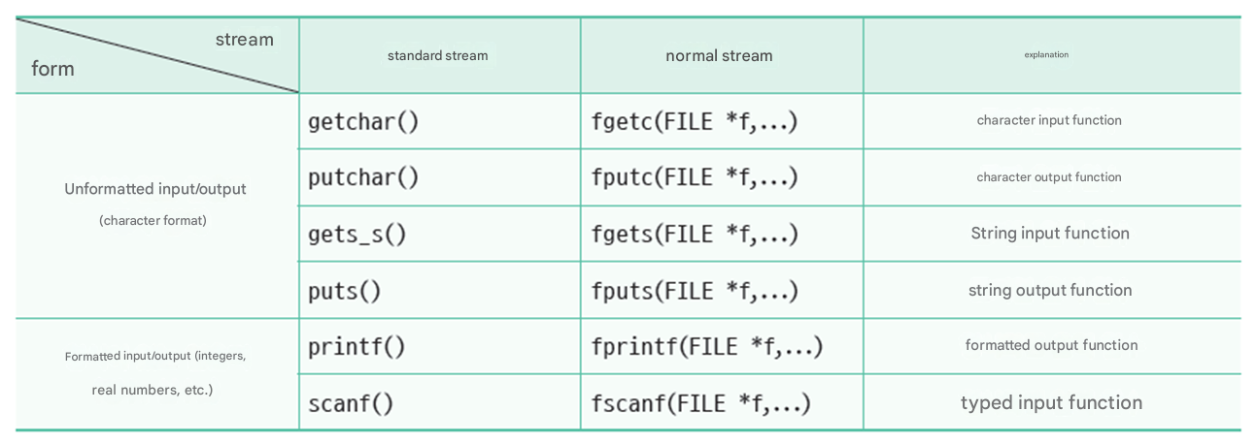
Classification of input/output functions

Slide 7
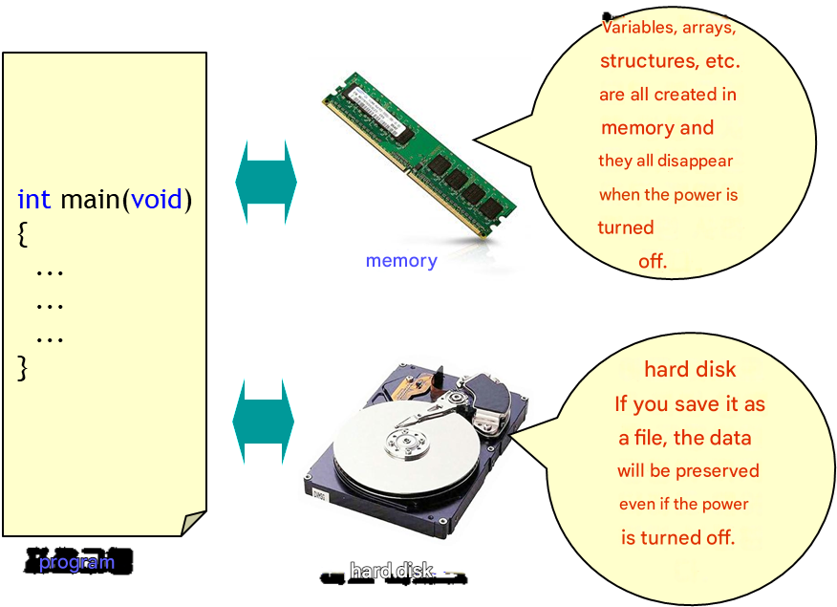
Why do I need files?

Slide 8
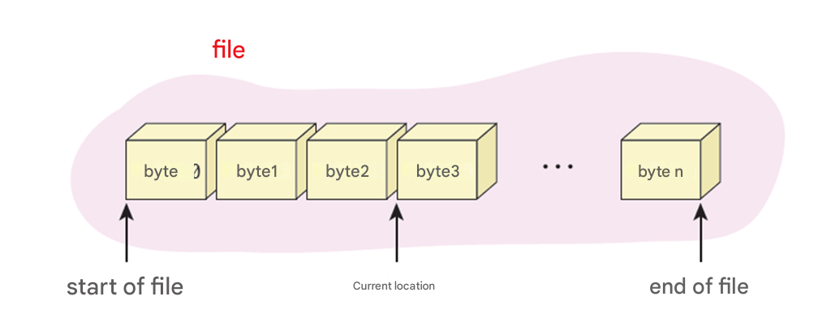
The concept of a file
A file in C is a series of contiguous bytes.
All file data is eventually converted to bytes and stored in a file.
It is entirely up to the programmer to interpret these bytes.

Slide 9
file
A file contains 4 bytes, it can be interpreted as either integer data of type int or real number data of type float.
One integer ?
One mistake ?
4 characters ?
file
0x36
0x34
0x31
0x0

Slide 10
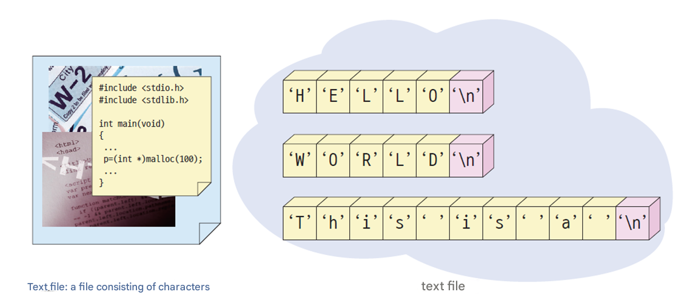
text file
A text file is a file that contains human-readable text.
( Example ) C program source file or notepad file
Text files are saved using ASCII codes.
A text file consists of consecutive lines.

Slide 11
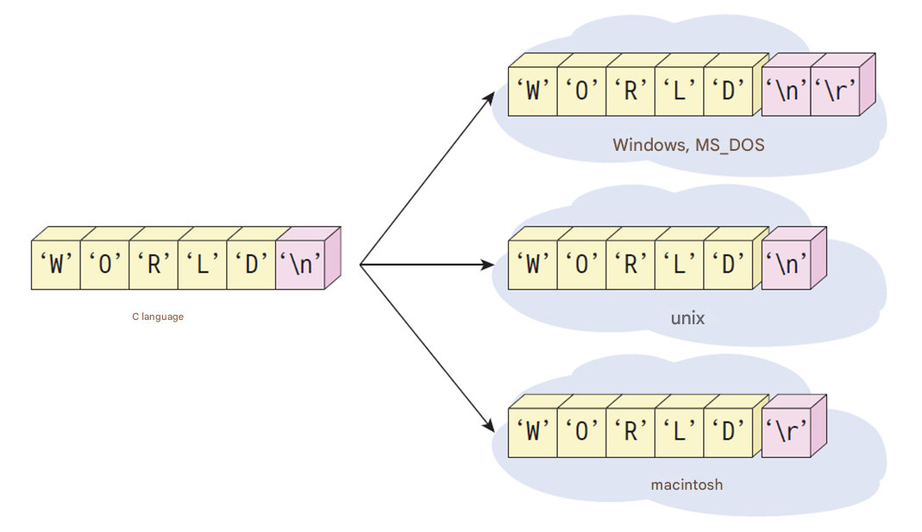
text file
Each operating system has a different way of displaying line breaks.

Slide 12
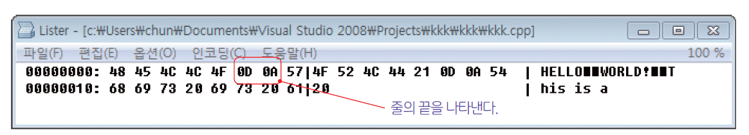
Text file in windows
For example, in Windows, text files are saved as shown in Figure 15-7 .

Slide 13
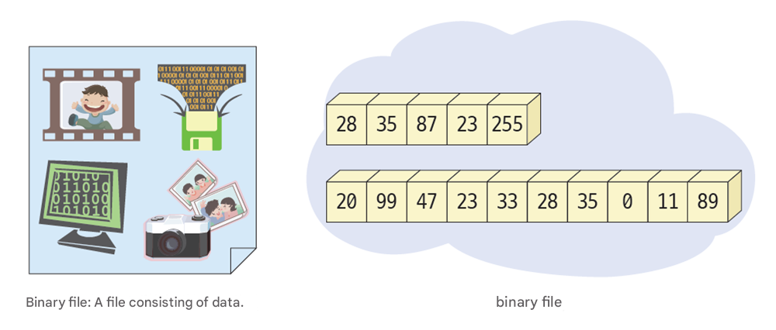
binary file
Binary files are files that cannot be read by humans but can be read by computers.
A file that directly stores binary data.
Binary files, unlike text files, are not separated into lines.
All data is input/output without being converted to strings.
Binary files can only be read by certain programs.
( Example ) C program executable file, sound file, image file

Slide 14
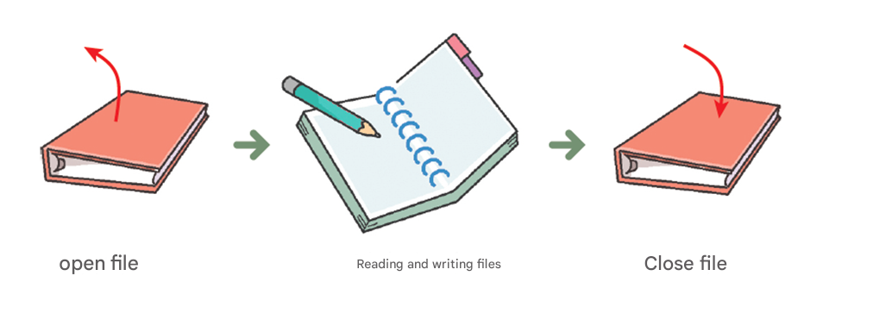
Overview of file processing
When handling files, you must follow this order :
Disk files are accessed using the FILE structure.
A file pointer is a pointer to a FILE structure.

Slide 15
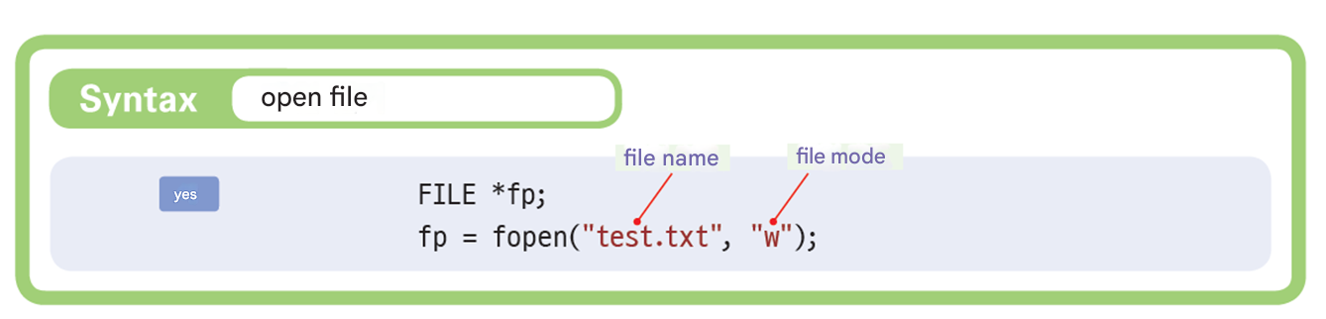
Open file

Slide 16
FILE structure
fopen () creates a file with the given file name and returns a FILE pointer .
struct _ iobuf {
char * _ptr ;
int _ cnt ;
char *_base;
int _flag;
int _file;
int _ charbuf ;
int _ bufsiz ;
char * _tmpfname ;
};
typedef struct _ iobuf FILE;

Slide 17
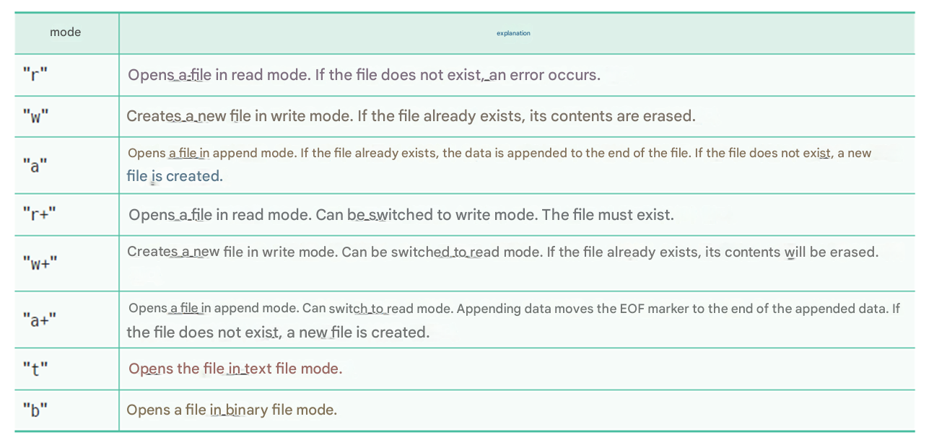
File Mode

Slide 18
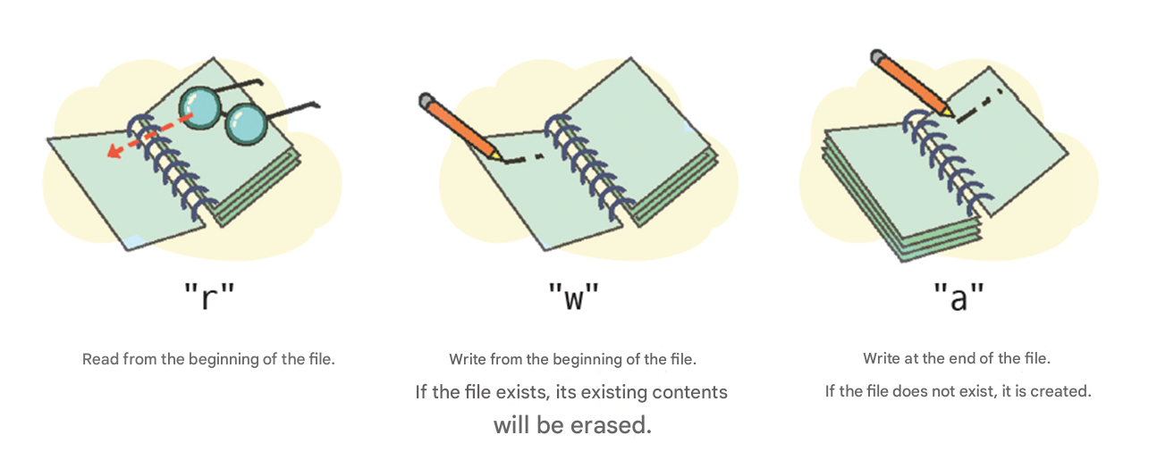
Basic file mode

Slide 19
Things to note
You can append "t" or "b" to the basic file mode .
"a" or "a+" mode is called append mode. When a file is opened in append mode, all write operations occur at the end of the file. Therefore, any existing data in the file is never erased.
the "r+", "w+", or "a+" file mode is specified, both reading and writing are possible. This mode is called update mode . To switch from read mode to write mode, or from write mode to read mode, you must call one of fflush(), fsetpos(), fseek(), or rewind() .

Slide 20
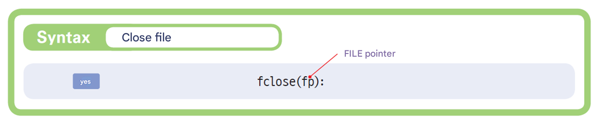
Close file

Slide 21

Example
#include < stdio.h >
int main( void )
{
FILE * fp = NULL;
fp = fopen ( "sample.txt" , "w" );
if ( fp == NULL )
printf ( " file opening Failed \n" );
else
printf ( " file opening Success \n" );
fclose ( fp );
return 0;
}
sample.txt
File opening success

Slide 22
File deletion example
#include < stdio.h >
int main( void )
{
if (remove( "sample.txt" ) == -1)
printf ( "sample.txt cannot be deleted .\n" );
else
printf ( "sample.txt has been deleted .\n" );
return 0;
}
sample.txt has been deleted .

Slide 23
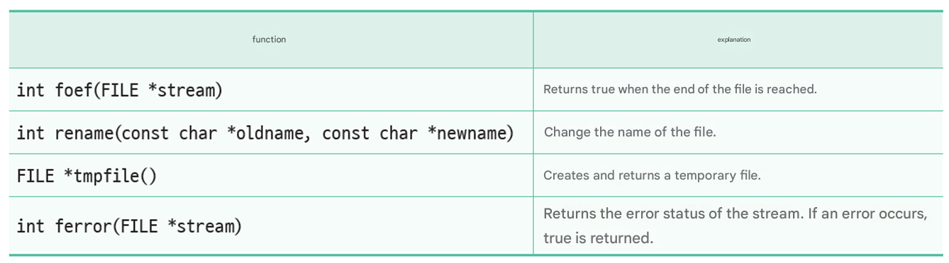
Other useful functions

Slide 24
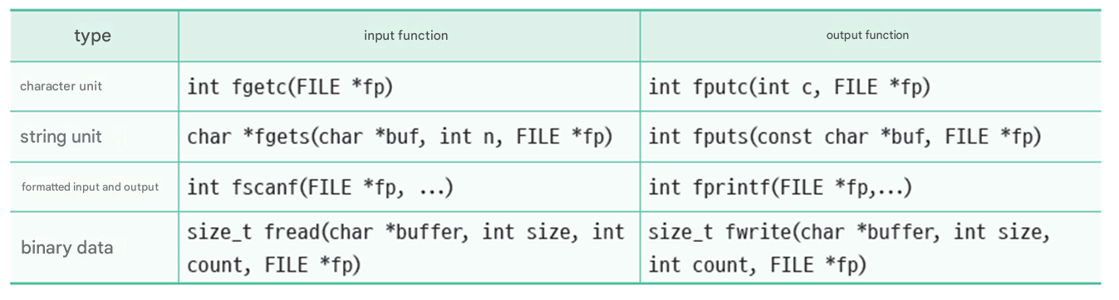
File input/output functions
Broadly speaking, it can be divided into text input/output functions and binary data input/output .

Slide 25

Character unit input/output
#include < stdio.h >
int main( void )
{
FILE * fp = NULL;
fp = fopen ( "sample.txt" , "w" );
if ( fp == NULL )
printf ( " file opening Failed \n" );
else
printf ( " file opening Success \n" );
fputc ('a', fp );
fputc ('b', fp );
fputc ('c', fp );
fclose ( fp );
return 0;
}
File open success

Slide 26
Character unit input/output
#include < stdio.h >
int main( void )
{
FILE * fp = NULL;
int c;
fp = fopen ( "sample.txt" , "r" );
if ( fp == NULL )
printf ( " file opening Failed \n");
else
printf ( " file opening Success \n");
while ((c = fgetc ( fp )) != EOF )
putchar (c);
fclose ( fp );
return 0;
}
must be declared as an integer variable. The reason is explained in the next slide .
File open success
abc

Slide 27
EOF
EOF(End Of File): A special symbol indicating the end of a file.
program
EOF
fgetc ()
…

Slide 28
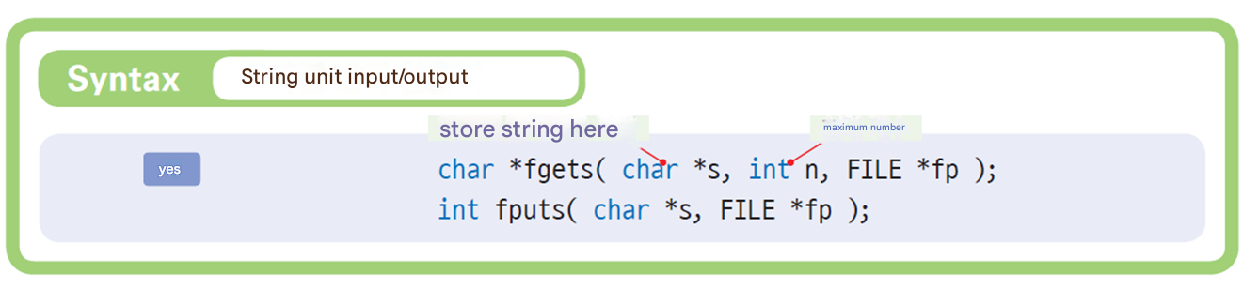
String unit input/output

Slide 29
String unit input/output
#include < stdio.h >
#include < stdlib.h >
int main( void )
{
FILE *fp1, *fp2;
char file1[100], file2[100];
char buffer[100];
printf ( " original file name : " );
scanf ( "%s" , file1);
printf ( " copy file name : " );
scanf ( "%s" , file2);
// first The file Read In mode Open .
if ( (fp1 = fopen (file1, "r" )) == NULL )
{
fprintf ( stderr , " original Cannot open file % s .\n" , file1);
exit(1);
}

Slide 30
String unit input/output
// second The file write In mode Open .
if ( (fp2 = fopen (file2, "w" )) == NULL )
{
fprintf ( stderr , " copy Cannot open file % s .\n" , file2);
exit(1);
}
// first The file second To file Copy .
while ( fgets (buffer, 100, fp1) != NULL )
fputs (buffer, fp2);
fclose (fp1);
fclose (fp2);
return 0;
}
Original file name: a.txt
Copy file name: b.txt

Slide 31
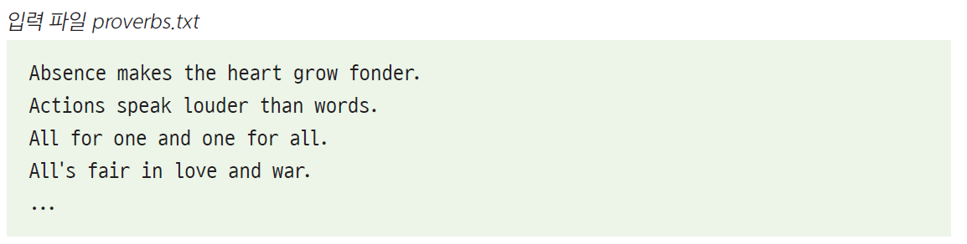
Lab: Finding a specific string in a file
Let's write a program that searches for a specific string in a text file. It takes the input text file name and the string to search for from the user.
Enter the input file name : proverbs.txt
Enter the word you want to search for : man
proverbs.txt: 16 Behind every good man is a good woman.
proverbs.txt: 41 A dog is a man's best friend.
proverbs.txt: 57 Early to bed and early to rise makes a man healthy, wealthy, and
wise.

Slide 32
#include < stdio.h >
#include < string.h >
int main( void )
{
FILE * fp ;
char fname [128], buffer[256], word[256];
int line_num = 0;
printf ( " Enter the input file name : " );
scanf ( "%s" , fname );
printf ( " Enter the word to search : " );
scanf ( "%s" , word);

Slide 33
// Open the file in read mode .
if (( fp = fopen ( fname , "r" )) == NULL )
{
fprintf ( stderr , " Cannot open file %s .\n" , fname );
exit(1);
}
while ( fgets (buffer, 256, fp )) {
line_num ++;
if ( strstr (buffer, word)) {
printf ( "%s: %d word %s found .\n" , fname , line_num , word);
}
}
fclose ( fp );
return 0;
}

Slide 34
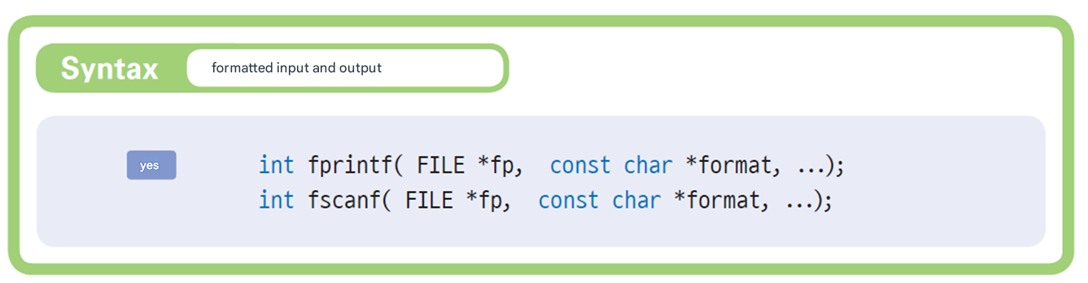
Formatted Input/Output

Slide 35
Example
int main( void )
{
FILE * fp ;
char fname [100];
int number, count = 0;
char name[20];
float score, total = 0.0;
printf ( " Grade file Name Enter : " );
scanf ( "%s" , fname );
// Grades The file write In mode Open .
if ( ( fp = fopen ( fname , "w" )) == NULL )
{
fprintf ( stderr , " grades Cannot open file % s .\n" , fname );
exit(1);
}

Slide 36
Example
// From the user Student number , name , and grades Input it In the file Save it.
while ( 1 )
{
printf ( " Student number , name , grade Please enter : ( if negative end )" );
scanf ( "%d" , &number);
if ( number < 0 ) break
scanf ( "%s %f" , name, &score);
fprintf ( fp , " %d %s %f" , number, name, score);
}
fclose ( fp );
// Grades The file Read In mode Open .
if ( ( fp = fopen ( fname , "r" )) == NULL )
{
fprintf ( stderr , " grades Cannot open file % s .\n" , fname );
exit(1);
}

Slide 37
Example
// from file Grades Read it The average Save .
while ( ! feof ( fp ) )
{
fscanf ( fp , "%d %s %f" , &number, name, &score);
total += score;
count++;
}
printf ( " average = %f\n" , total/count);
fclose ( fp );
return 0;
}
Enter the score file name : scores.txt
Enter your student number , name , and grade : ( end if negative )1 KIM 10.0
Enter your student number , name , and grade : ( end if negative )2 PARK 20.0
Enter your student number , name , and grade : ( end if negative )3 LEE 30.0
Enter your student number , name , and grade : ( end if negative ) -1
Average = 20.000000

Slide 38
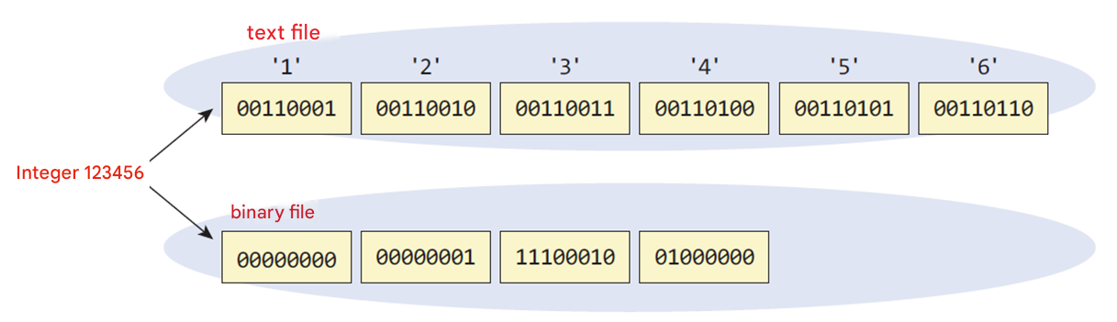
Writing and reading binary files
Difference between text files and binary files
Text file : All data is converted to ASCII code and saved.
Binary file : Stores data exactly as it is represented on a computer.

Slide 39
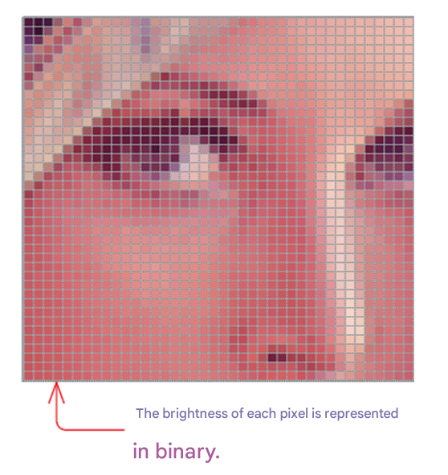
Example of a binary file
Image file or sound file

Slide 40
Write binary file
#include < stdio.h >
#define SIZE 5
int main( void )
{
int buffer[ SIZE ] = { 10, 20, 30, 40, 50 };
FILE * fp = NULL ;
fp = fopen ( " binary.bin " , " wb " ); // ①
if ( fp == NULL )
{
fprintf ( stderr , " binary.bin Cannot open file ." );
return 1;
}
fwrite (buffer, sizeof ( int ), SIZE , fp ); // ②
fclose ( fp );
return 0;
}

Slide 41
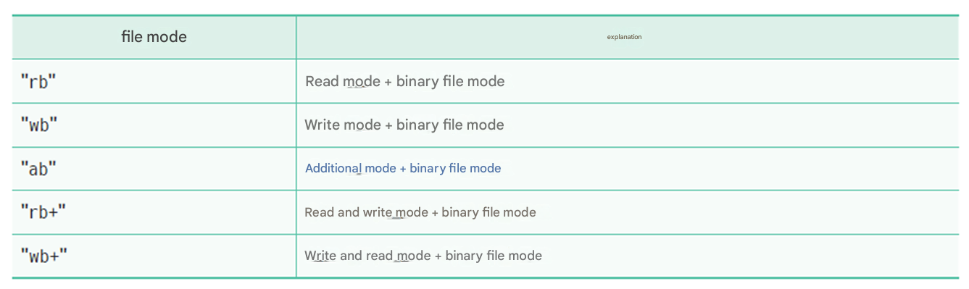
Binary file mode

Slide 42
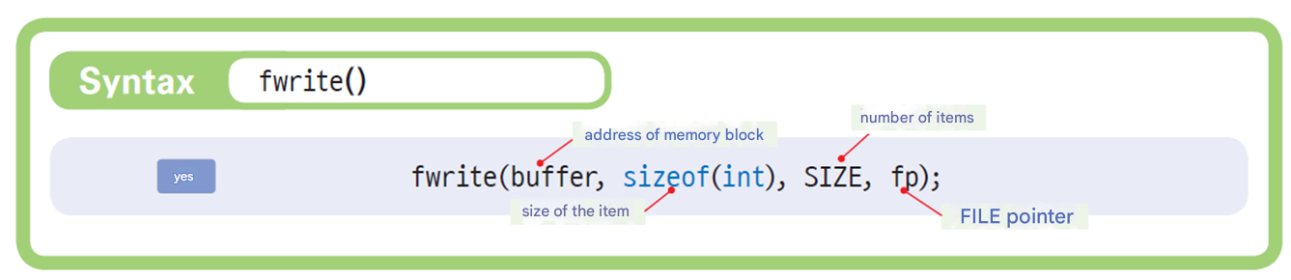
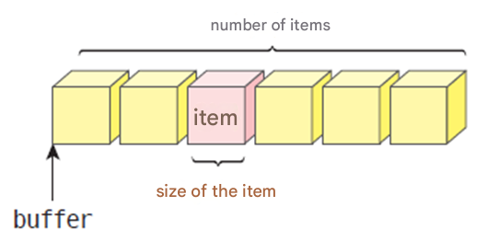
Write binary file
fwrite (buffer, size, count, fp )
buffer is the starting address of the memory block that contains the data to be written to the file .
size is the size of the item being stored, in bytes .
count is the number of items you want to store. If you want to write 10 int type data, the item size will be 4 and the number of items will be 10 .
fp is a FILE pointer .

Slide 43
Reading binary files
#include < stdio.h >
#define SIZE 5
int main( void )
{
int i ;
int buffer[ SIZE ];
FILE * fp = NULL ;
fp = fopen ( " binary.bin " , " rb " );
if ( fp == NULL )
{
fprintf ( stderr , " binary.bin Cannot open file ." );
return 1;
}
fread (buffer, sizeof ( int ), SIZE , fp );
for (i = 0; i < SIZE ; i++)
printf ( "%d " , buffer[ i ]);
fclose ( fp );
return 0;
}
10 20 30 40 50

Slide 44
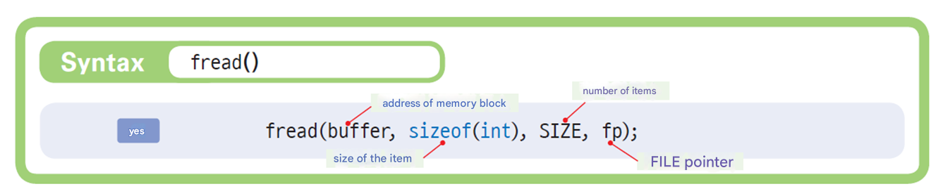
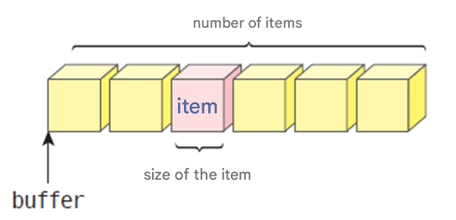
Reading binary files
fread (buffer, size, count, fp )
buffer is the starting address of the memory block that contains the data to be written to the file .
size is the size of the item being stored, in bytes .
count is the number of items you want to store . If you want to write 10 int type data, the item size will be 4 and the number of items will be 10 .
fp is a FILE pointer .

Slide 45
Buffering
A buffer is a block of memory used as a temporary storage location for data read from and written to a file.
Since disk drives are block-unit devices, they operate most efficiently when input/output is performed in block units.
Blocks of 1024 bytes are common.
file
disk
Buffer

Slide 46
Buffering
fflush( fp );
The contents of the buffer are written to a disk file .
Setbuf( fp , NULL);
setbuf () is a function that directly specifies the buffer of the stream. If NULL is written in place of the buffer, it means that the buffer will be removed.

Slide 47
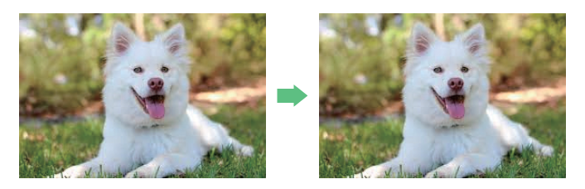
Lab: Image Copy files
Here, we will write a program that copies binary files .
Image file name : dog.jpg
Image file copied as copy.jpg

Slide 48
hint
To read or write a binary file, append “ b” to the file mode when calling fopen () . To open a write-only file, use “ wb ” , and to open a read-only file, use “ rb ” .
src_file = fopen ("pome.jpg", " rb ");
dst_file = fopen ("copy.jpg", " wb ");
To read data from a binary file, use fread () .
fread (buffer, 1, sizeof (buffer), src_file );
To write data to a binary file, use fwrite () .
fwrite (buffer, 1, sizeof (buffer), dst_file );
fread () returns the number of items successfully read , so if it returns 0 , it can be considered that the end of the file has been reached .

Slide 49
Example
#include < stdio.h >
int main( void )
{
FILE * src_file , * dst_file ;
char filename[100];
char buffer[1024];
int r_count ;
printf ( " Image file name : " );
scanf ( "%s" , filename);
src_file = fopen(filename, "rb" );
dst_file = fopen ( "copy.jpg" , " wb " );
if ( src_file == NULL || dst_file == NULL ) {
fprintf ( stderr , " File open error \n" );
return 1;
}

Slide 50
Example
while (( r_count = fread (buffer, 1, sizeof (buffer), src_file )) > 0) {
int w_count = fwrite (buffer, 1, r_count , dst_file );
if ( w_count < 0) {
fprintf ( stderr , " File writing error \n" );
return 1;
}
if ( w_count < r_count ) {
fprintf ( stderr , " Media write error \n" );
return 1;
}
}
printf ( " Image file copied as copy.jpg \n" );
fclose ( src_file );
fclose ( dst_file );
return 0;
}

Slide 51
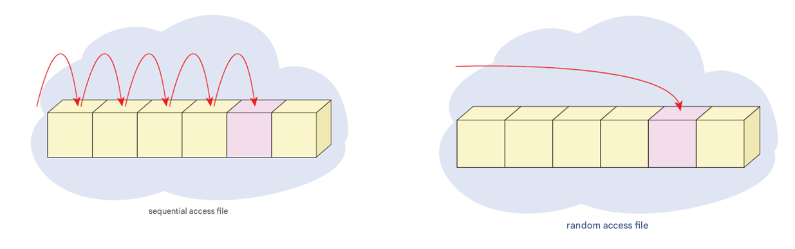
Random access files
Sequential access Method : How to read or write data sequentially from the beginning of a file
random access Method : How to read and write from any location in the file

Slide 52
Principles of random access files
File pointer : Indicates the current location of the file where read and write operations are taking place.
Forcibly moving the file pointer allows random access
file Pointer

Slide 53
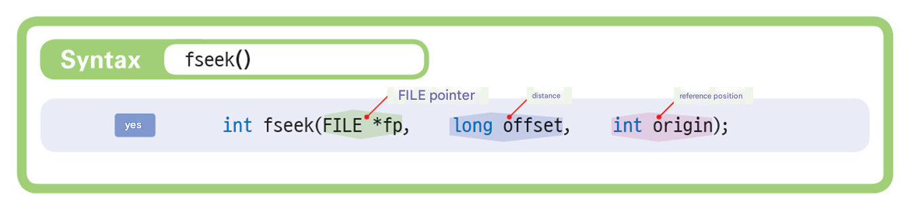
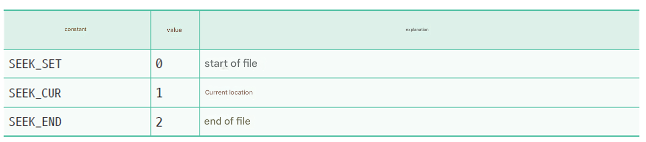
fseek ()

Slide 54
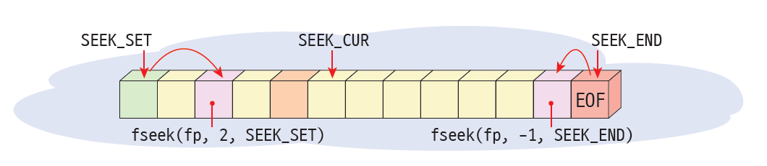
fseek ()
rewind ( fp ): Initializes the file pointer to the beginning .

Slide 55
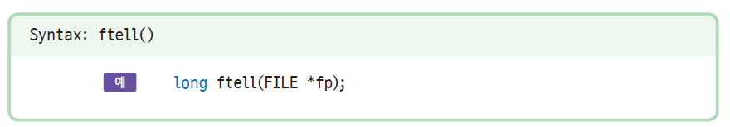
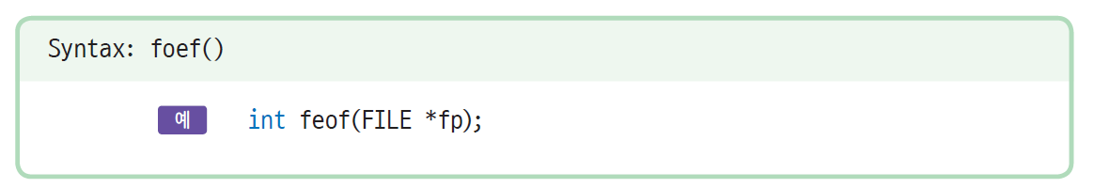
ftell(), feof()
Returns the current position of the file pointer
Returns whether the end of file has been reached

Slide 56
Mini Project: Creating an Address Book
Let's write a simple program that can store and update information about yourself and your friends.
Data entered or updated is saved as a file. Saved data can be searched .
Let's create our own simple database system that will allow us to store various things we need.

Slide 57
Execution results
====================
1. Add
2. Modification
3. Search
4. End
====================
Integer value Enter : 1
Name : Hong Gil-dong
Address : 1 Jongno -gu, Seoul
Mobile phone : 010-1234-5678
Features : Superpower Superhero

Slide 58
hint
The suitable one is “ a+” mode . It is mainly for adding and exploring.
You must always use fseek () before reading from a file .
When making modifications, it is better to create a new file and rewrite the entire thing there .

Slide 59
Example
#include < stdio.h >
#include < string.h >
#define SIZE 100
typedef struct person { // Represent contact information as a structure .
char name[SIZE]; // name
char address[SIZE]; // address
char mobilephone [SIZE]; // mobile phone
char desc [SIZE]; // Features
} PERSON;
void menu();
PERSON get_record ();
void print_record (PERSON data);
void add_record (FILE * fp );
void search_record (FILE * fp );
void update_record (FILE * fp );

Slide 60
my
int main( void )
{
FILE * fp ;
int select;
// Open the binary file in append mode .
if ( ( fp = fopen ( "address.dat" , "a+" )) == NULL ) {
fprintf ( stderr , " Cannot open file for input );
exit(1);
}
while (1) {
menu(); // Display the menu
printf ( " Enter an integer value : " ); // Get an integer from the user
scanf ( "% d" ,&select );
switch (select) {
case 1: add_record ( fp ); break; // Add data
case 2: update_record ( fp ); break; // Modify data
case 3: search_record ( fp ); break; // Explore the data
case 4: return 0;
}
}
fclose ( fp ); // Close the binary file
return 0;
}

Slide 61
// Receive data from the user and return it as a structure
PERSON get_record ()
{
PERSON data;
fflush ( stdin ); // Clear the standard input buffer
printf ( " name ); gets(data.name); // Enter
printf ( " address ); gets( data.address ); // Enter
printf ( " cell phone ); gets( data.mobilephone ); // Enter
printf ( " Features ); gets( data.desc ); // Receive features
return data;
}
// Print the structure data to the screen .
void print_record (PERSON data)
{
printf("Name\n", data.name); printf("Address\n" , data.address );
printf("Mobile phone\n", data.mobilephone ); printf("Features\n" , data.desc );
}

Slide 62
// Function to display the menu on the screen
void menu()
{
printf ( "====================\n" );
printf ( " 1. Add \n 2. Modify \n 3. Search \n 4. End \n" );
printf ( "====================\n" );
}
// Add data
void add_record (FILE * fp )
{
PERSON data;
data = get_record (); // Receive data from the user and store it in a structure
fseek ( fp , 0, SEEK_END); // go to the end of the file
fwrite (&data, sizeof (data), 1, fp ); // Write structure data to a file
}

Slide 63
// Explore the data
void search_record (FILE * fp )
{
char name[SIZE];
PERSON data;
fseek ( fp , 0, SEEK_SET); // go to the beginning of the file
fflush ( stdin );
printf ( " The name of the person you want to search for " );
gets(name); // Enter
while (! feof ( fp )){ // repeat until the end of the file
fread (&data, sizeof (data), 1, fp );
if ( strcmp (data.name, name) == 0 ){ // Compare names
print_record (data);
break;
}
}
}
// Modify data
void update_record (FILE * fp )
{
//...
}

Slide 64
Q & A

